Slide 1
OGC API – Tiles Sprint
Webinar
16th April 2020

Slide 2
Webinar Agenda
Welcome - Gobe Hobona (OGC)
Motivation for the Sprint - Peter Parslow / Michael Gordon (Ordnance Survey)
OGC API - Tiles draft specification - Joan Maso (UAB - CREAF)
OGC API – Common draft specification - Chuck Heazel (Heazel Tech)
Description of sprint - Gobe Hobona (OGC)
Questions & Answers

Slide 3
Welcome
OGC and Ordnance Survey invite you to the OGC API – Tiles Sprint being held virtually on:
Day 1: Thursday 23rd April from 09:00am BST / 10:00am CEST / 04:00am EDT
Day 2: Friday 24th April, 2020 from 09:00am BST / 10:00am CEST / 04:00am EDT
Finishing at 05:00pm BST / 06:00pm CEST / 12:00pm EDT
What is an OGC Sprint?
A collaborative and inclusive event driven by innovative and rapid programming with minimum process and organization constraints to support the development of new applications and open standards.

Slide 4
Motivation for the Sprint
Ensuring there are modern API standards for common app elements
WMTS is the most used OGC web service standard – let’s make sure the
next generation is too!
Over the next few years, OS will be creating the next-generation of
authoritative data for Great Britain
– we want to provide access using modern, easy to use OGC standards ☺

Slide 5
OGC API - Tiles draft specification

Slide 6
OGC API – Common draft specification

Slide 7
Description of the sprint

Slide 8
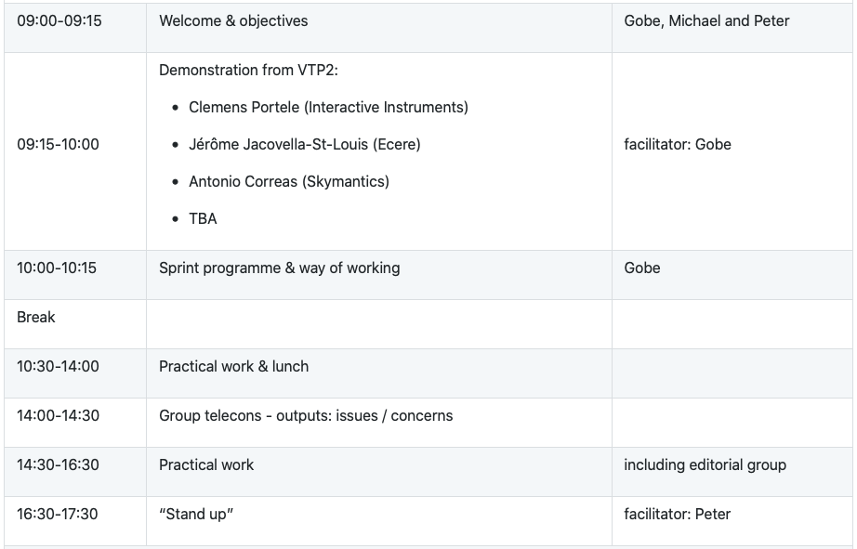
Sprint Schedule – April 23rd, 2020

Slide 9
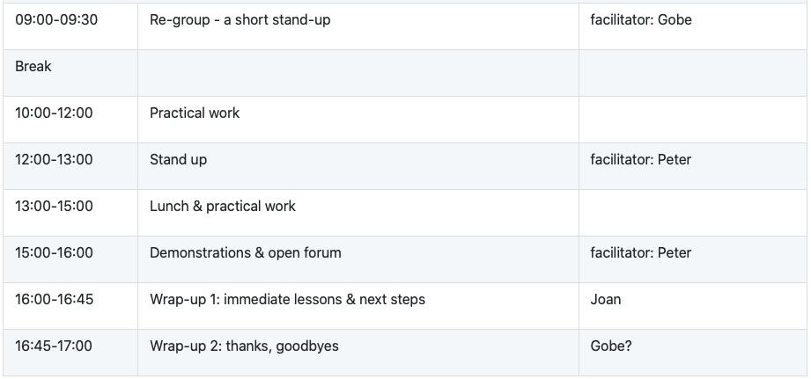
Sprint Schedule – April 24th, 2020

Slide 10
Logistics
Gotomeeting
Link to be provided to registered participants only.
Gitter
One persistent meeting room
GitHub
Public repo https://github.com/opengeospatial/OGC-OS-Sprint-04-2020

